Slide 1
CS4038
DATA MINING
LECTURE # 26
SPRING 2024
FAST – NUCES, CFD CAMPUS
Ayesha Liaqat
ayesha.liaqat@nu.edu.pk

Slide 2
TODAY’S TOPICS
Association Rule Mining
Support, Confidence
Apriori principle
Candidate support-based pruning
Apriori algorithm

Slide 3
ASSOCIATION RULE MINING
Given a set of transactions, find rules that will predict the occurrence of an item based on the occurrences of other items in the transaction
A.k.a Market-Basket Problem
Market-Basket transactions
Example of Association Rules
TID | Items
1 | Bread, Milk
2 | Bread, Diaper, Beer, Eggs
3 | Milk, Diaper, Beer, Coke
4 | Bread, Milk, Diaper, Beer
5 | Bread, Milk, Diaper, Coke
{Diaper} → {Beer},
{Milk, Bread} → {Eggs,Coke},
{Beer, Bread} → {Milk},
Implication means co-occurrence, not causality!

Slide 4
THE MARKET-BASKET PROBLEM
Given a database of transactions
where each transaction is a collection of items (purchased by a customer in a visit)
find all rules that correlate the presence of one set of items with that of another set of items
Example: 30% of all transactions that contain diapers also contain beers; 5% of all transactions contain these items
30%: confidence of the rule
5%: support of the rule
We are interested in finding all rules, rather than verifying that a particular rule holds
Notes:
Supp: measures frequency/prevalence of itemset in the whole dataset
Conf: measure strength of association b/w 2 itemsets in a rule

Slide 5
APPLICATIONS OF MARKET-BASKET ANALYSIS
Supermarkets
Placement
Advertising
Sales
Coupons
Many applications outside market basket data analysis
Prediction (telecom switch failure)
Web usage mining
Many different types of association rules
Temporal
Spatial
Causal

Slide 6
DEFINITION: ITEMSET & SUPPORT COUNT
Itemset
A collection of one or more items
Example: {Milk, Bread, Diaper}
k-itemset
An itemset that contains k items
Support count (σ)
Frequency of occurrence of an itemset
E.g. σ({Milk, Bread, Diaper}) = 2
Frequent Itemset
An itemset whose support is greater than or equal to a minsup threshold
TID | Items
1 | Bread, Milk
2 | Bread, Diaper, Beer, Eggs
3 | Milk, Diaper, Beer, Coke
4 | Bread, Milk, Diaper, Beer
5 | Bread, Milk, Diaper, Coke

Slide 7
DEFINITION: ASSOCIATION RULE
Association Rule
An implication expression of the form X → Y, where X and Y are itemsets
Example:
{Milk, Diaper} → {Beer}
Rule Evaluation Metrics
Support (s)
Fraction of transactions that contain both X and Y
Confidence (c)
Measures how often items in Y appear in transactions that contain X
TID | Items
1 | Bread, Milk
2 | Bread, Diaper, Beer, Eggs
3 | Milk, Diaper, Beer, Coke
4 | Bread, Milk, Diaper, Beer
5 | Bread, Milk, Diaper, Coke
Example:
{Milk, Diaper} ⇒ {Beer}
_{s =} σ (Milk, Diaper,Beer) ₌ 2 _{= 0.4}
| T | 5
_{c =} σ (Milk, Diaper,Beer) ₌ 2 _{= 0.67}
σ (Milk, Diaper) 3
Notes:
Supp: measures frequency of occurrence /prevalence of itemset in the whole dataset
Conf: measure strength of association b/w 2 itemsets in a rule

Slide 8
PRACTICE WORK
Example of Rules:
{Milk,Diaper} → {Beer} (s=0.4, c=0.67)
{Milk,Beer} → {Diaper}
{Diaper,Beer} → {Milk}
{Beer} → {Milk,Diaper}
{Diaper} → {Milk,Beer}
{Milk} → {Diaper,Beer}
TID | Items
1 | Bread, Milk
2 | Bread, Diaper, Beer, Eggs
3 | Milk, Diaper, Beer, Coke
4 | Bread, Milk, Diaper, Beer
5 | Bread, Milk, Diaper, Coke
Compute the support and confidence of the above rules.

Slide 9
SOLUTION
Example of Rules:
{Milk,Diaper} → {Beer} (s=0.4, c=0.67)
{Milk,Beer} → {Diaper} (s=0.4, c=1.0)
{Diaper,Beer} → {Milk} (s=0.4, c=0.67)
{Beer} → {Milk,Diaper} (s=0.4, c=0.67)
{Diaper} → {Milk,Beer} (s=0.4, c=0.5)
{Milk} → {Diaper,Beer} (s=0.4, c=0.5)
TID | Items
1 | Bread, Milk
2 | Bread, Diaper, Beer, Eggs
3 | Milk, Diaper, Beer, Coke
4 | Bread, Milk, Diaper, Beer
5 | Bread, Milk, Diaper, Coke

Slide 10
ASSOCIATION RULE MINING TASK
Given a set of transactions T, the goal of association rule mining is to find all rules having
support ≥ minsup threshold
confidence ≥ minconf threshold
The real question is that how can we find such rules from a transaction database?

Slide 11
ASSOCIATION RULE MINING TASK
Approach 1: Brute-force method
List all possible association rules
Compute the support and confidence for each rule
Prune rules that fail the minsup and minconf thresholds
⇒ Computationally prohibitive!

Slide 12
MINING ASSOCIATION RULES
Example of Rules:
{Milk,Diaper} → {Beer} (s=0.4, c=0.67)
{Milk,Beer} → {Diaper} (s=0.4, c=1.0)
{Diaper,Beer} → {Milk} (s=0.4, c=0.67)
{Beer} → {Milk,Diaper} (s=0.4, c=0.67)
{Diaper} → {Milk,Beer} (s=0.4, c=0.5)
{Milk} → {Diaper,Beer} (s=0.4, c=0.5)
Observations:
All the above rules are binary partitions of the same itemset:
{Milk, Diaper, Beer}
Rules originating from the same itemset have identical support but can have different confidence
Thus, we may decouple the support and confidence requirements
TID | Items
1 | Bread, Milk
2 | Bread, Diaper, Beer, Eggs
3 | Milk, Diaper, Beer, Coke
4 | Bread, Milk, Diaper, Beer
5 | Bread, Milk, Diaper, Coke

Slide 13
MINING ASSOCIATION RULES
Two-steps approach:
Frequent Itemset Generation
Generate all itemsets whose support ≥ minsup
Rule Generation
Generate high confidence rules from each frequent itemset, where each rule is a binary partitioning of a frequent itemset
Frequent itemset generation is still computationally expensive

Slide 14
FREQUENT ITEMSET GENERATION

Slide 15
FREQUENT ITEMSET GENERATION
null
A
B
C
D
E
Given d items, there are 2^{d} possible candidate itemsets
AB
AC
AD
AE
BC
BD
BE
CD
CE
DE
ABC
ABD
ABE
ACD
ACE
ADE
BCD
BCE
BDE
CDE
ABCD
ABCE
ABDE
ACDE
BCDE
ABCDE
16

Slide 16
FREQUENT ITEMSET GENERATION
Brute-force approach:
Each itemset in the lattice is a candidate frequent itemset
Count the support of each candidate by scanning the database
Match each transaction against every candidate
Complexity ~ O(NMw) => Expensive since M = 2^{d} !!!
Transactions
List of Candidates
TID | Items
1 | Bread, Milk
2 | Bread, Diaper, Beer, Eggs
3 | Milk, Diaper, Beer, Coke
4 | Bread, Milk, Diaper, Beer
5 | Bread, Milk, Diaper, Coke
N
M
w
17
Notes:
N: transactions
M: itemsets
W:width of transactions

Slide 17
FREQUENT ITEMSET GENERATION STRATEGIES
Reduce the number of candidates (M)
Complete search: M=2^{d}
Use pruning techniques to reduce M
Reduce the number of transactions (N)
Reduce size of N as the size of itemset increases
Used by direct hashing and pruning, and vertical-based mining algorithms
Reduce the number of comparisons (NM)
Use efficient data structures to store the candidates or transactions
No need to match every candidate against every transaction
Notes:
Larger itemsets not appear very often
Hash table/tree

Slide 18
REDUCING NUMBER OF CANDIDATES
Apriori principle:
If an itemset is frequent, then all of its subsets must also be frequent
Apriori principle holds due to the following property of the support measure:
∀X,Y ∈ J: (X⊆Y) → s(X) ≤ s(Y)
Support of an itemset never exceeds the support of its subsets
This is known as the monotone (or upward closed) property of support

Slide 19
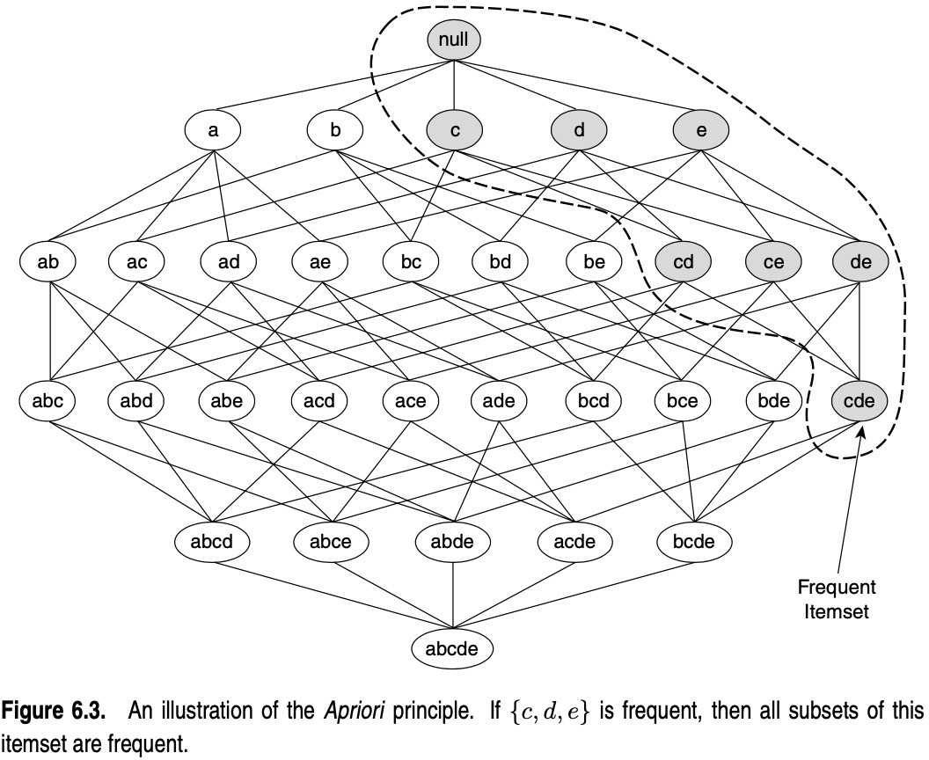

Slide 20
REDUCING NUMBER OF CANDIDATES
Apriori principle:
If an itemset is frequent, then all of its subsets must also be frequent
Conversely, if an itemset is infrequent, then all of its supersets must be infrequent too.
∀X,Y ∈ J: (X⊆Y) → s(Y) ≤ s(X)
This is known as the anti-monotone (or downward closed) property of support
This strategy of trimming the exponential search space based on the support measure is known as support-based pruning.

Slide 21
null
A
B
C
D
E
AB
AC
AD
AE
BC
BD
BE
CD
CE
DE
Found to be Infrequent
ABC ABD
ABE
ACD
ACE
ADE
BCD
BCE
BDE
CDE
ABCD
ABCE
ABDE
ACDE
BCDE
Pruned supersets
ABCDE

Slide 22
ILLUSTRATING APRIORI PRINCIPLE
Items (1-itemsets)
TID | Items
1 | Bread, Milk
2 | Beer, B read, Diaper, Eggs
3 | Beer, Coke, Diaper, Milk
4 | Beer, B read, Diaper, Milk
5 | Bread, Coke, Diaper, Milk
Item | Count
Bread | 4
Coke | 2
Milk | 4
Beer | 3
Diaper | 4
Eggs | 1
Minimum Support = 3

Slide 23
ILLUSTRATING APRIORI PRINCIPLE
TID | Items
1 | Bread, Milk
2 | Beer, B read, Diaper, Eggs
3 | Beer, Coke, Diaper, Milk
4 | Beer, B read, Diaper, Milk
5 | Bread, Coke, Diaper, Milk
Items (1-itemsets)
Item | Count
Bread | 4
Coke | 2
Milk | 4
Beer | 3
Diaper | 4
Eggs | 1
Minimum Support = 3

Slide 24
ILLUSTRATING APRIORI PRINCIPLE
 |  |  | TID | Items
 |  |  | 1 | Bread, Milk
 |  |  | 2 | Beer, B read, Diaper, Eggs
 |  |  | 3 | Beer, Coke, Diaper, Milk
 |  |  | 4 | Beer, B read, Diaper, Milk
 |  |  | 5 | Bread, Coke, Diaper, Milk
Items (1-itemsets)
Item | Count
Bread | 4
Coke | 2
Milk | 4
Beer | 3
Diaper | 4
Eggs | 1
Itemset
{Bread,Milk}
{Bread, Beer }
{Bread,Diaper}
{Beer, Milk}
{Diaper, Milk} {Beer,Diaper}
Pairs (2-itemsets)
Minimum Support = 3
(No need to generate candidates involving Coke or Eggs)

Slide 25
ILLUSTRATING APRIORI PRINCIPLE
TID | Items
1 | Bread, Milk
2 | Beer, B read, Diaper, Eggs
3 | Beer, Coke, Diaper, Milk
4 | Beer, B read, Diaper, Milk
5 | Bread, Coke, Diaper, Milk
Items (1-itemsets)
Item | Count
Bread | 4
Coke | 2
Milk | 4
Beer | 3
Diaper | 4
Eggs | 1
Itemset | Count
{Bread,Milk} | 3
{Beer, Bread} 2
{Bread,Diaper} | 3
{Beer,Milk} 2
{Diaper,Milk} {Beer,Diaper} | 3 3
Pairs (2-itemsets)
Minimum Support = 3

Slide 26
ILLUSTRATING APRIORI PRINCIPLE
 |  |  | TID | Items
Items (1-itemsets) Item Count
 |  |  | 1 | Bread, Milk
 |  |  | 2 | Beer, B read, Diaper, Eggs
 |  |  | 3 | Beer, Coke, Diaper, Milk
 |  |  | 4 | Beer, B read, Diaper, Milk
 |  |  | 5 | Bread, Coke, Diaper, Milk
Bread | 4
Coke | 2
Milk | 4
Beer | 3
Diaper | 4
Eggs | 1
Itemset | Count
{Bread,Milk} | 3
{Beer, Bread} 2
{Bread,Diaper} | 3
{Beer,Milk} 2
{Diaper,Milk} {Beer,Diaper} | 3 3
Pairs (2-itemsets)
Minimum Support = 3
Triplets (3-itemsets)
Itemset
{ Beer, Diaper, Milk}
{ Beer,Bread,Diaper}
{Bread,Diaper,Milk}
{ Beer, Bread, Milk}

Slide 27
ILLUSTRATING APRIORI PRINCIPLE
 |  |  | TID | Items
 |  |  | 1 | Bread, Milk
 |  |  | 2 | Beer, B read, Diaper, Eggs
 |  |  | 3 | Beer, Coke, Diaper, Milk
 |  |  | 4 | Beer, B read, Diaper, Milk
 |  |  | 5 | Bread, Coke, Diaper, Milk
Items (1-itemsets)
Item | Count
Bread | 4
Coke | 2
Milk | 4
Beer | 3
Diaper | 4
Eggs | 1
Itemset | Count
{Bread,Milk} | 3
{Beer, Bread} 2
{Bread,Diaper} | 3
{Beer,Milk} 2
{Diaper,Milk} {Beer,Diaper} | 3 3
Pairs (2-itemsets)
Minimum Support = 3
Triplets (3-itemsets)
Itemset
Count
{ Beer, Diaper, Milk} 2
{ Beer,Bread, Diaper} 2
{Bread, Diaper, Milk}
2
{Beer, Bread, Milk}
1

Slide 28
THE IDEA OF THE APRIORI ALGORITHM
start with all 1-itemsets
go through data and count their support and find all “large” 1-itemsets
combine them to form “candidate” 2-itemsets
go through data and count their support and find all “large” 2-itemsets
combine them to form “candidate” 3-itemsets
large itemset: itemset with support > s
candidate itemset: itemset that may have support > s
...

Slide 29
APRIORI ALGORITHM
F_{k}: frequent k-itemsets
L_{k}: candidate k-itemsets
Join Step: C_{k} is generated by joining L_{k-1}with itself
Prune Step: Any (k-1)-itemset that is not frequent cannot be a subset of a frequent k-itemset
Algorithm
Let k=1
Generate F₁ = {frequent 1-itemsets}
Repeat until F_{k} is empty
Candidate Generation: Generate L_{k+1} from F_{k}
Candidate Pruning: Prune candidate itemsets in L_{k+1} containing subsets of length k that are infrequent
Support Counting: Count the support of each candidate in L_{k+1} by scanning the DB
Candidate Elimination: Eliminate candidates in L_{k+1} that are infrequent, leaving only those that are frequent => F_{k+1}

Slide 30
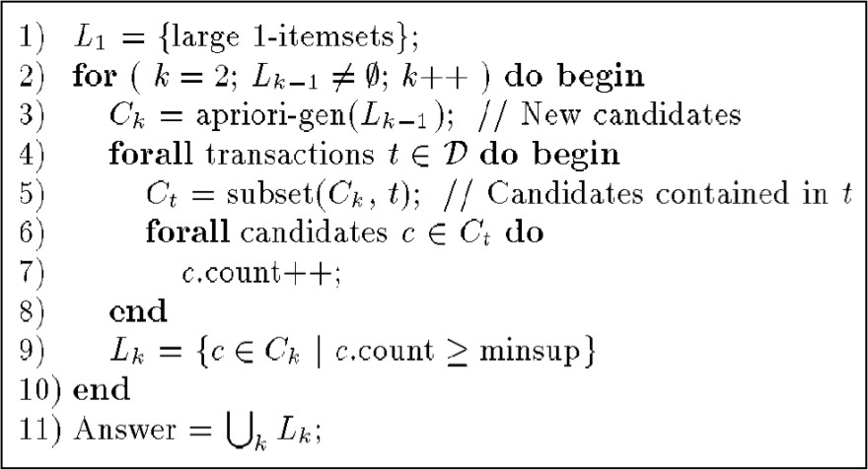
APRIORI ALGORITHM from AGARWAL et al. (1993)

Slide 31
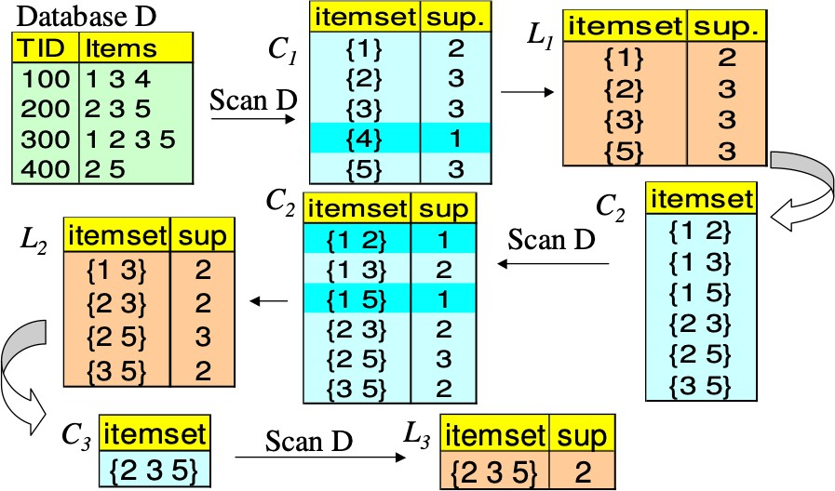
APRIORI ALGORITHM (EXAMPLE: s = 50%)

Slide 32
REFERENCES
Chapter 6:Tan, Steinbach & Kumar
Chapter 6: Han, Kamber & Pei
43

